Slide 1
That Project was a Rollercoaster: An ERP test of Deliberate Metaphor Theory
Sophie Greene¹, Joanna Morris², Daniel Altshuler²
¹ Tufts University^{, 2} Hampshire College

Slide 2
A metaphor is a novel linguistic expression used outside of its normal conventional meaning to refer to an entity, property or relation it does not literally denote.
Metaphors have generally been considered rare, ornamental linguistic phenomena, restricted to the domains of poetry and literature.
However, in conceptual metaphor theory (CMT), metaphor is recast as fundamentally conceptual in nature, in that it establishes correspondences between concepts from disparate domains of knowledge. (Lakoff and Johnson, 1980)
In this framework, familiar metaphors, e.g. “we have come a long way” are linguistic manifestations of underlying conceptual relationships such as “love is a journey” or “argument is war.”
CMT claims that our entire conceptual system is metaphorical and that these conceptual metaphors are present in everyday, conventional communication.

Slide 3
The classical view of metaphor interpretation once held that a hearer first attempts to process a metaphor literally; but if the literal interpretation turns out to be false, an interpretation is sought that renders the utterance true.
This is because conversations are cooperative efforts undertaken in pursuit of a common communicative goal (Grice, 1975); participants in a conversation make contributions that advance the shared goal, by offering information that they believe to be true (the maxim of quality).
If listeners believe that a speaker adheres to the cooperative principle, a literally false metaphorical utterance of the form ‘an a is a b’ forces them to search for an alternative interpretation.
This alternative, metaphorical interpretation is reached by engaging in a form of implicit comparison via which the hearer compares the features of ‘a’ , the target, with those of ‘b’, the vehicle.
Notes:
Comparison: This approach treats metaphors as comparisons that highlight preexisting but potentially obscure similarities between the target and base concepts. The process is assumed to be one of feature matching.
Problems: Metaphoric mappings often involve the projection of new information from the base to the target. The computer metaphor of mind was not informative be- cause it simply highlighted certain well-known aspects of the mind that were also true of computers but rather because it promoted a transfer of knowledge from the domain of computers to that of minds. Feature-matching models provide no mechanism for the projection of such distinctive base properties.
Nor do they suggest any means for predicting which distinctive base properties will be inferred of the target.

Slide 4
An alternative view of metaphor interpretation is that metaphors are not processed as comparisons, but rather as categorical assertions, where the entity ‘a’ is claimed to be a member of the superordinate category ‘b’.
Bowdle and Gentner (2005) unify these positions by asserting that as metaphors are conventionalized, there is a shift in mode of processing from comparison to categorization; novel metaphors are processed by comparison alone, whereas conventional metaphors can be processed either by categorization or comparison.
However, whether a metaphor is processed by comparison or categorization is determined not only by its novelty, but also its form.
When a conventional metaphor takes the form of a simile, it is processed by comparison; in contrast when a novel metaphor takes the form of ‘an a is a b’, people process the target as an instance of the source category, i.e. by categorization.
Notes:
However, it has been shown that literal and, at least, familiar metaphorical sentences are equally easy to comprehend suggesting that literal meanings are not necessarily computer first.
Some researchers have used the limitations of feature-matching models to argue that cross-domain mappings between metaphor targets and bases are mediated by abstract metaphoric categories.
Categorization: The literal target and base concepts of a metaphor are never placed in direct correspondence during metaphor comprehension. Rather, the base concept is used to access or derive an abstract metaphoric category of which it represents a prototypical member, and the target concept is then assigned to that category.

Slide 5
Steen (2008) argues that the process of metaphor interpretation, i.e. comparison vs. categorisation, is driven by both the metaphorical form that a speaker chooses to use, as well as the communicative function that the metaphor is intended to serve.
The deliberate use of a metaphor is a rhetorical strategy that ‘changes the addressee’s perspective on the referent or topic that is the target of the metaphor, by making the addressee look at it from a different conceptual domain or space.” (Steen, 2008, p. 222)
Hence, a deliberate metaphor is one that is used by speakers for the explicit purpose of being recognized and understood as metaphorical.
Steen (2008) argues that analogies and similes, are the clearest examples of deliberate metaphors, because they explicitly invite comparisons between the target and source domains.

Slide 6
Taken together these findings lead to what Steen terms ‘the paradox of metaphor’, i.e. contrary to the claims of CMT, most words and phrases typically seen as conveying metaphorical meaning, by virtue of not being intentionally metaphorical, are not processed as cross-domain mappings and, therefore, are not truly ‘metaphorical’.

Slide 7
If so, we should find differences between (a) the processing of metaphors when preceded by pragmatic cues signaling the intention of the speaker for the utterance to be interpreted metaphorically, and (b) the processing of metaphors in the absence of such cues.
To test this hypothesis we examined event-related potential (ERP) responses to cued (deliberate) and uncued (non-deliberate) metaphors.

Slide 8
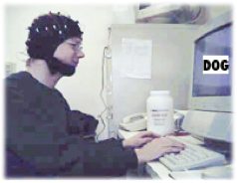
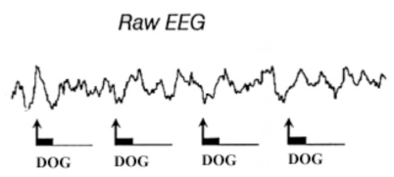
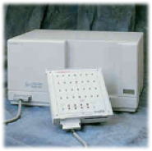
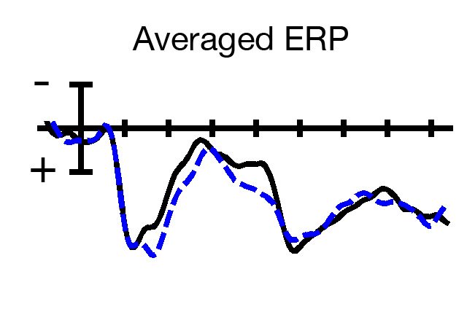

ERPs are voltage changes in the on-going electroencephalogram that are time-locked to the onset of a sensory or motor event; they allow us to closely tie cognitive processes to brain function.

Slide 9
Notes:
Two components have been commonly reported for metaphors, the N400 and the P600/LPC (Pynte et al.,1996; Coulson and Van Petten, 2002; De Grauwe et al., 2010; Schmidt-Snoek et al., 2015).
Changes in the amplitude of the N400 may reflect the ease of mapping the meaning(s) of incoming words onto semantic memory structure and sentence and discourse level context, while the P600 has been traditionally linked to syntactic reanalysis, although recent studies have suggested that it also reflects semantic and interpretation processes, such as sentence-level interpretation conflicts (Frenzel et al., 2011) and integration in the wider discourse model and communicative context.
Most studies reported a biphasic N400-P600 effect, assumed to link different stages in conceptual mapping (Coulson and Van Petten, 2002; De Grauwe et al., 2010). Other authors reported an N400 response only (Pynte et al., 1996), or a P600 only, described as a form of a reanalysis stage (Yang et al., 2013).

Slide 10
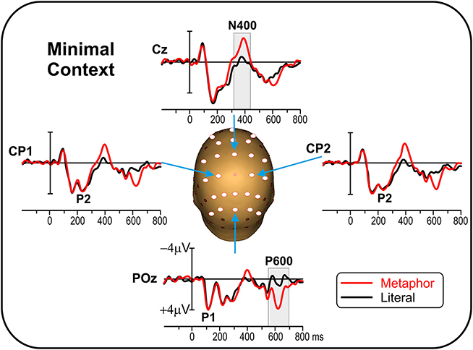
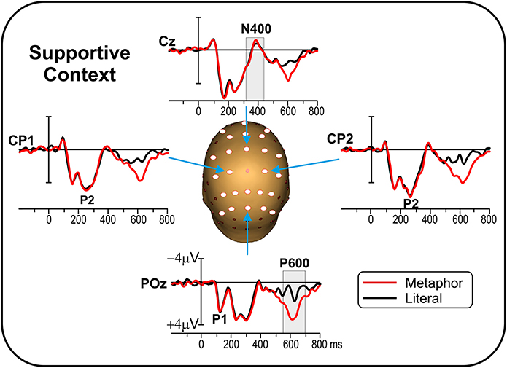
In a recent study looking at the role of context in metaphor processing, Bambini et al. (2016) found a greater N400 for metaphors in a minimal versus a supportive context, suggesting that discourse cues may modulate metaphorical processing.

Slide 11
Participants read 100 metaphorical and 100 literal sentences, with and without a pragmatic cue to metaphorical status.
Sentences were presented one word at a time, at a rate that was meant to simulate natural reading, and participants were instructed to read for comprehension.
 | Metaphor | Non-Metaphor
No Cue | John is an elephant. | Boston is a city.
Cue | John is like an elephant. | Boston is like a city.
Notes:
The materials were 100 metaphor sentences, 100 non-metaphor sentences, and 200 filler sentences. Metaphor sentences were of the structure “A is a B,” and were presented either with or without the pragmatic marker “like.”
Non-metaphor sentences were of the same structure, and were also presented either with or without the pragmatic marker “like.”
10% of sentences were followed by comprehension questions to ensure the participant was paying attention. These were simple yes-or-no questions directly related to the preceding sentence.

Slide 12
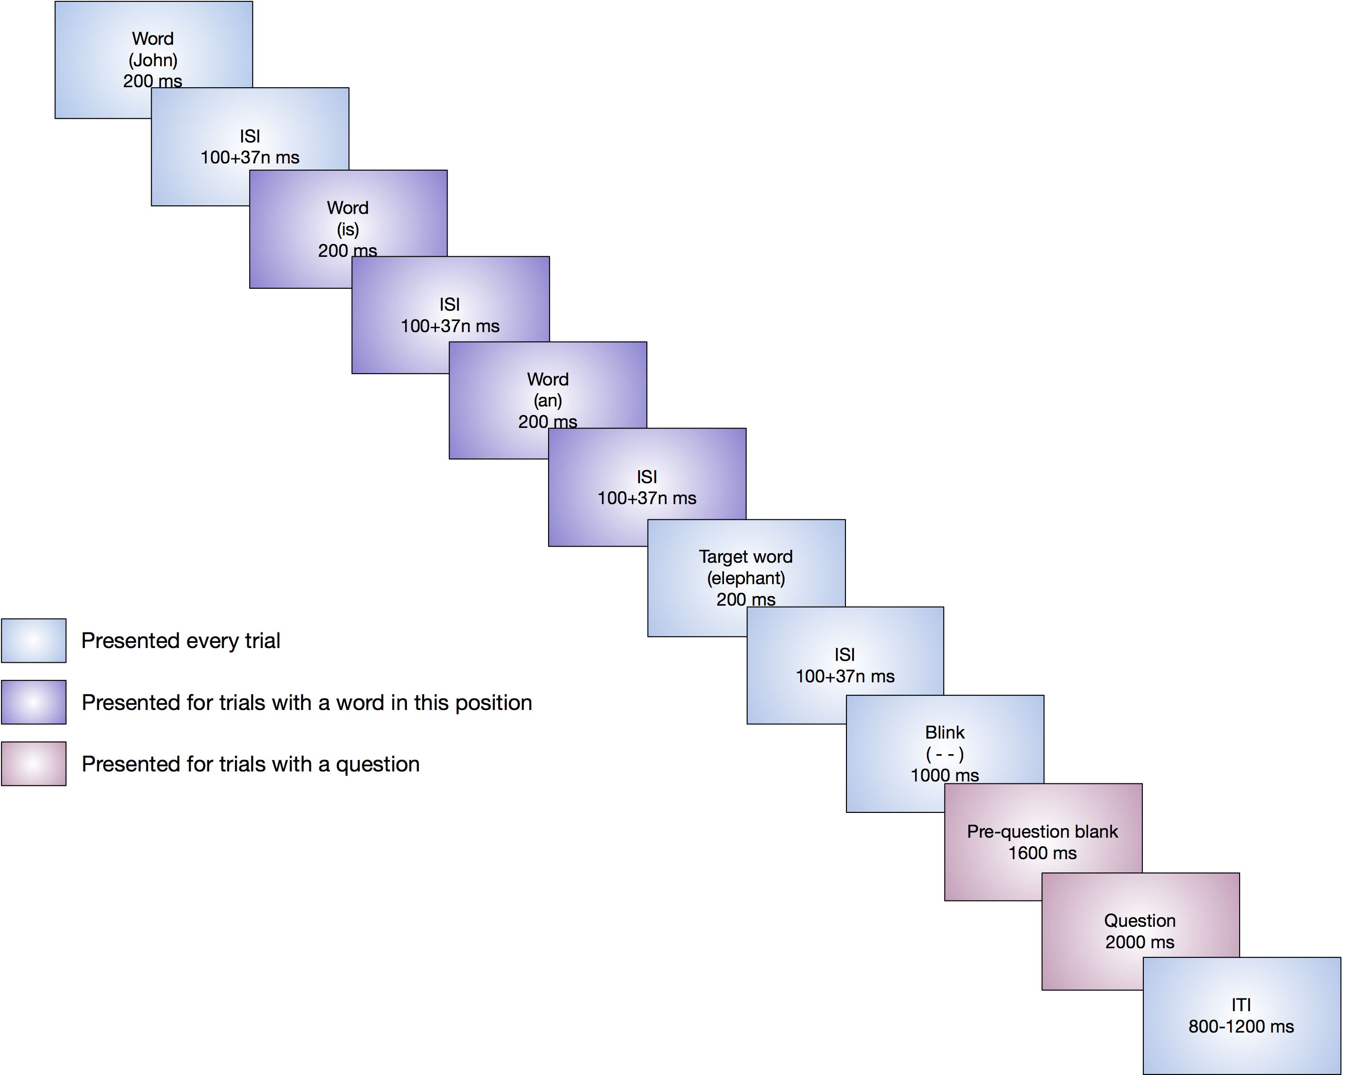
Notes:
Each word was presented for 200 ms, and the interword interval was dependent on the length of the preceding word, at 100 ms plus an additional 37 ms for each character in the word (see Coulson and Petten, 2002; Lai and Curran, 2013; Lai et al., 2009, and others). After the final word and interword interval, participants saw a symbol on the screen (“ ( - - ) ”) for 1000 ms that indicated a blink break. For trials with questions, following the blink break there was a blank screen for 1600 ms, and then the question appeared. The question remained on the screen for 2000 ms or until the participant made their response with the keyboard. The question was followed by a variable intertrial interval of 800-1200 ms.

Slide 13
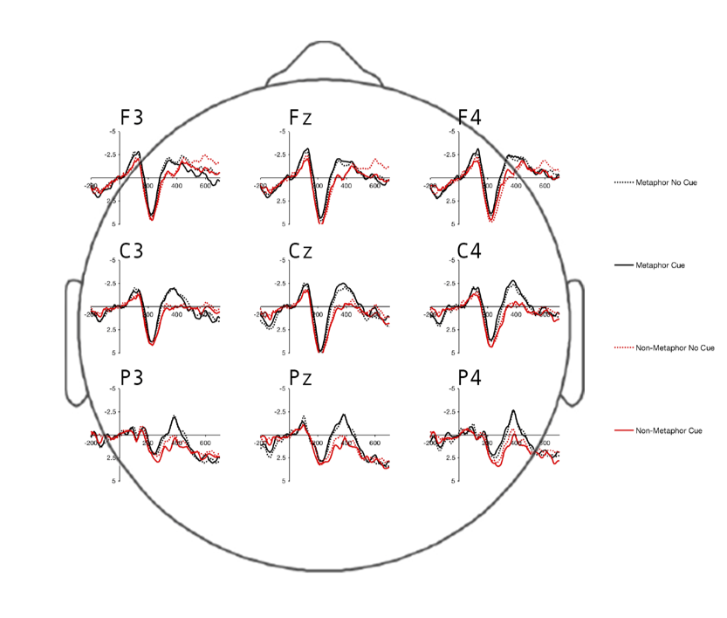
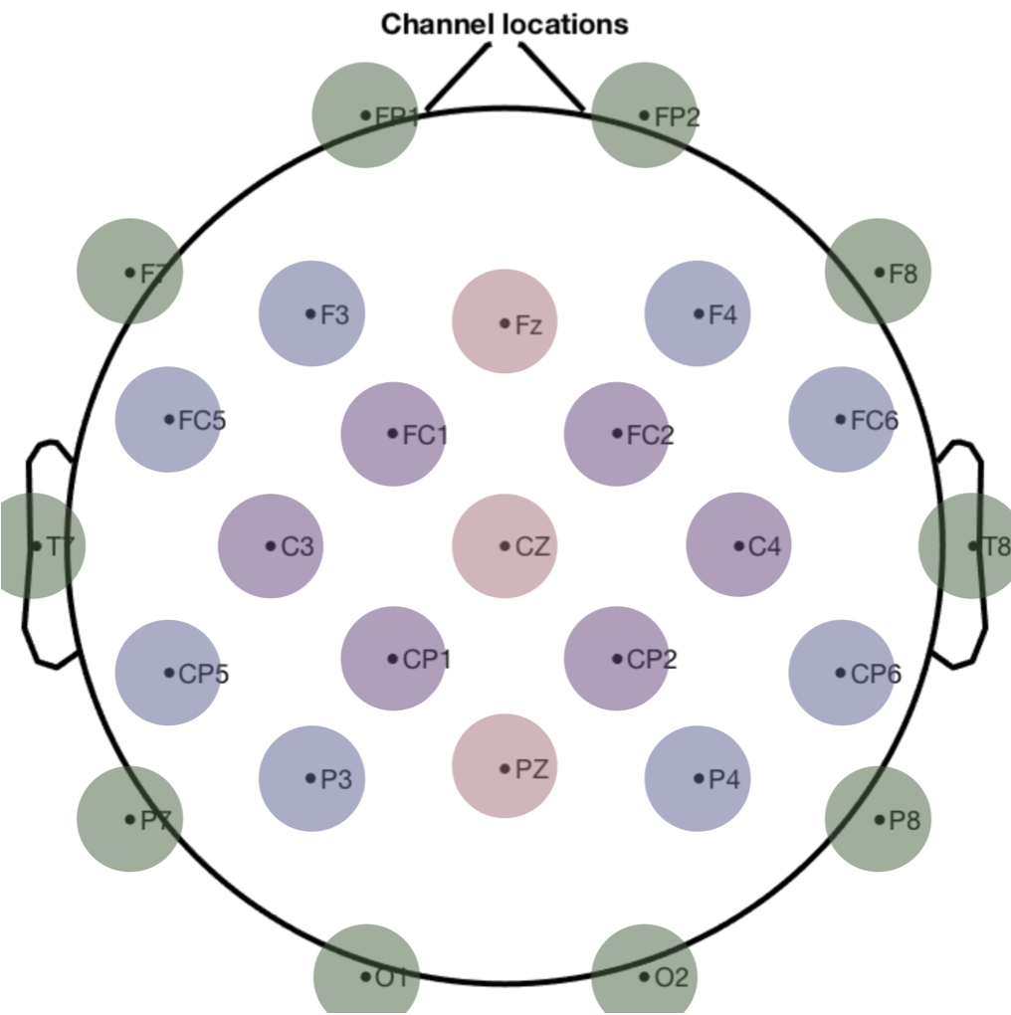

Slide 15
Summary
Metaphors generally elicit greater N400 amplitudes than literal sentences and this is what we found.
However, we found show no differences in N400 amplitude between cued (deliberate) and uncued (non-deliberate) metaphors.
All metaphors, deliberate or not, produced uniformly greater N400s than non-metaphor sentences. Therefore, the results of this study do not provide any evidence in support of Deliberate Metaphor Theory.

